Slide 1


From Soil to Server : Enhancing Plant Care Through Real-Time Monitoring
Akash Verma
12208873
A14
Rohan Lohani
12214962
A30
Tanya
12213410
A56
Submitted to
Deepika Ghai
123456

Slide 2
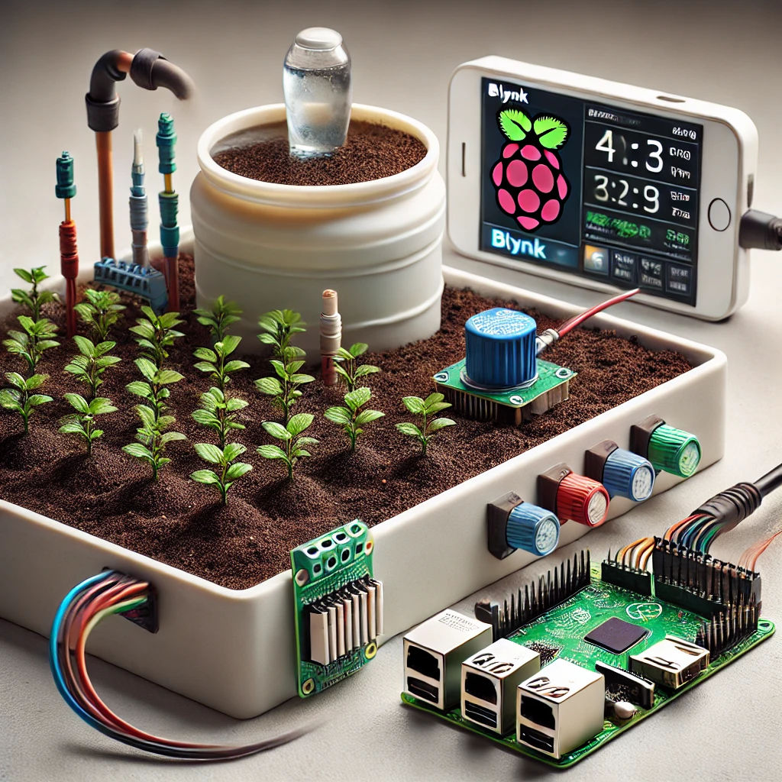
Introduction
This project aims to improve plant care by automating irrigation.
Uses sensors to monitor soil moisture, water levels, and environmental conditions.
Includes a water pump controlled automatically by the Blynk app.
All data is stored and monitored in real-time for better insights.
A buzzer provides alerts when the water level in the tank is low.
Designed to make irrigation more efficient and less labor-intensive.
Combines IoT technology with practical applications in agriculture.

Slide 3
Applications
Automated Irrigation: Ensures plants receive adequate water without manual effort
Water Conservation: Optimizes water usage based on soil and weather conditions
From Soil to Server : Enhancing Plant Care Through Real-Time Monitoring
Data track :
Keeps track of soil moisture, humidity, and water usage.
Remote Monitoring: Enables users to check and control irrigation from anywhere.

Slide 4
Libraries Used
Adafruit_Sensor Library – For interfacing with various sensors accurately.
Blynk Library – Connects the system to the Blynk app for remote monitoring and control
DHT Library – Handles data from the DHT sensor for temperature and humidity.
LCD I2C Library – For displaying real-time data on the LCD screen.
RPi.GPIO Library: Provides GPIO control on the Raspberry Pi, managing the relay module and pump.

Slide 5
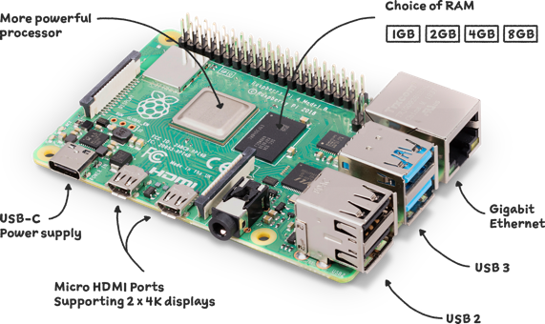
Working of Project
Step 1:
Raspberry Pi
Input:
Collects data from soil moisture, water level, and DHT sensors.
Receives control commands from the Blynk app.
Output:
Activates pump via relay based on sensor data.
Sends alerts (e.g., low water level) to Blynk and triggers buzzer.
Displays readings on LCD and logs data in Blynk for tracking.

Slide 6
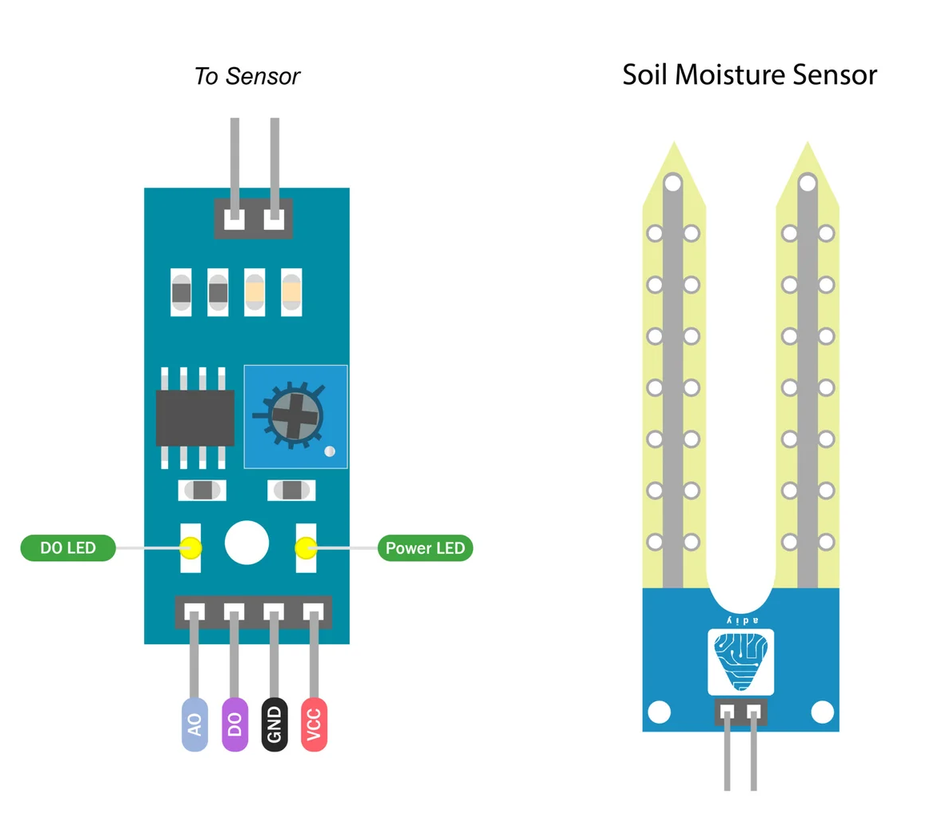
Step 2:
Soil Moisture Sensor
Input:
Soil moisture sensor detects moisture level in the soil.
Output:
Raspberry Pi reads moisture data, triggering the water pump if moisture level is low.

Slide 7
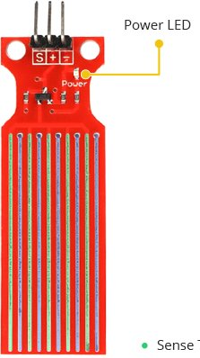
Step 3:
Water Level Sensor
Input:
Water level sensor monitors the water tank level.
Output:
Buzzer sounds if water is low, alerting the user to refill the tank.

Slide 8
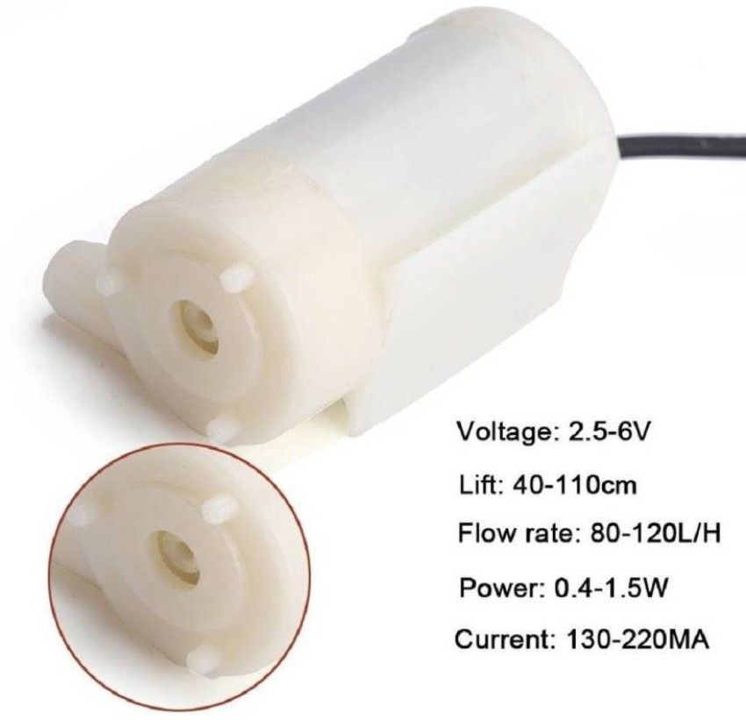
Step 4:
Water Pump
Input:
Signal sent to turn on the water pump.
Output:
Water pump starts to water the plants.

Slide 9
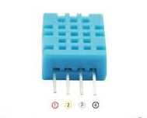
Step 5:
DHT Sensor
Input:
DHT sensor captures the temperature and humidity.
Output:
Data displayed on LCD and used to adjust watering needs based on environmental conditions.

Slide 10
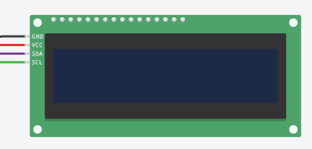
Step 6:
LCD Display
Input:
Sensor data processed by Raspberry Pi.
Output:
LCD shows current sensor readings, and buzzer alerts for low water levels.

Slide 11

Step 7:
Blynk App
Input:
User commands via Blynk app to control the water pump.
Output:
Remote control of irrigation system, real-time data display.

Slide 12
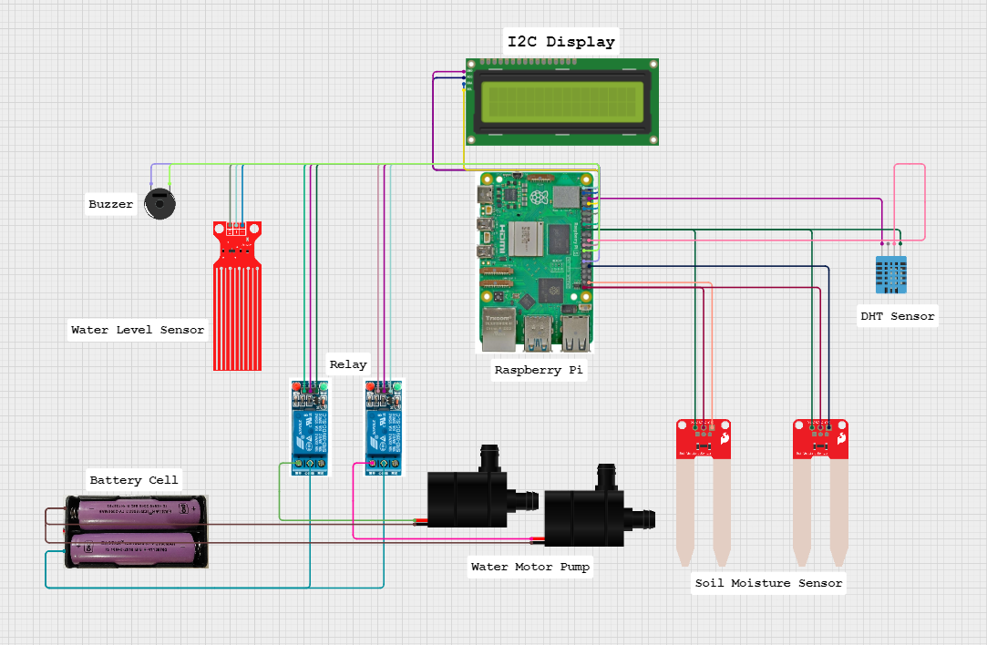
Complete Process of Project Working

Slide 13
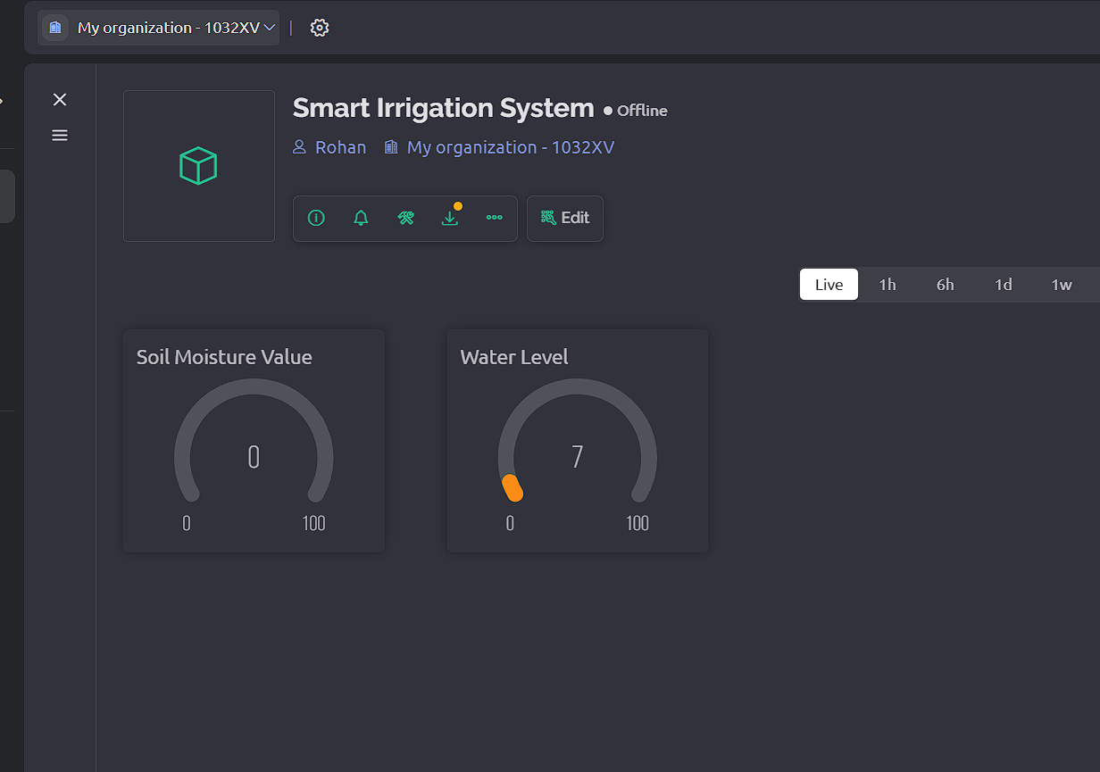
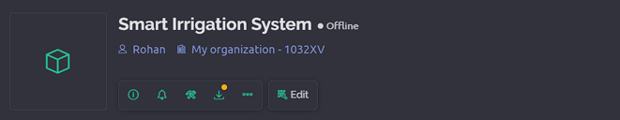
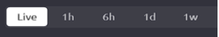
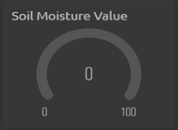
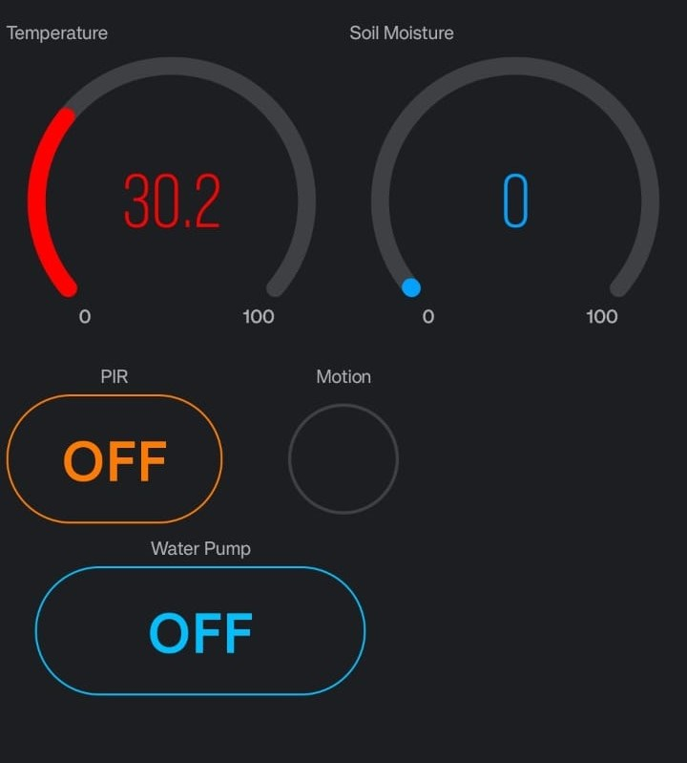
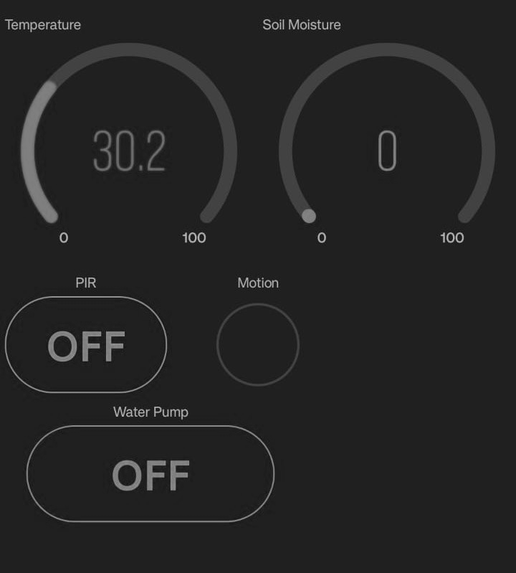
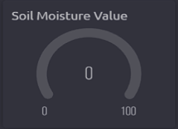
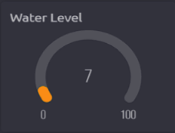
Blynk Console

Slide 14
Conclusion
Summary of Project Goals: This project aimed to develop a smart irrigation system that automates the watering process using IoT and sensors. The system ensures plants receive water only when necessary by monitoring soil moisture, environmental temperature, and humidity. This approach reduces the risk of over-watering or under-watering.
Efficiency Gains: By automating irrigation based on real-time data, the system saves water, reducing waste compared to traditional irrigation methods. It also minimizes the need for human intervention, allowing users to spend less time on manual watering tasks and ensuring plants are watered even if the user is away.
Ease of Use: The use of the Blynk app enables real-time monitoring and remote control. Users can receive updates, view sensor readings, and control the irrigation system from anywhere with an internet connection, making it especially beneficial for those managing multiple plants or larger agricultural areas.

Slide 15
Future Scopes
Advanced Data Analytics: The current system could be upgraded with machine learning algorithms that analyze historical data (e.g., past moisture levels, seasonal weather patterns) to predict optimal irrigation schedules. This predictive capability would make the system smarter, adapting over time to improve water efficiency further.
Weather Forecast Integration: Integrating weather data would make the system even more efficient. For example, if rain is forecasted, the system could delay irrigation, conserving water. This feature would allow the system to react not only to current conditions but also to expected changes in the environment.
Expansion to Other Environments: Beyond outdoor agriculture, this system can be adapted to controlled environments like vertical farms, hydroponics, and urban gardening, where precise control over water and nutrient delivery is crucial. The same system architecture can be applied in these scenarios with minimal modification.
Multi-Platform Support: Currently, the system may only be compatible with the Blynk app. Expanding compatibility to other IoT platforms like Google Home, Alexa, or custom IoT dashboards would make it more versatile, enabling users with different smart-home ecosystems to use the system seamlessly.

Slide 16
References
[1] Pappula, M., Myneni, J. C., Gandra, M., Tadigadapa, R., & Akella, B. K. M. (2024). Blynk-Powered IoT system with machine learning for personalized plant care. 2024 8th International Conference on Inventive Systems and Control (ICISC)
[2] R, V., R, A. K., & M, K. (2024). GreenSense: IoT-Enabled smart monitoring and Early detection system for optimal plant health in Greenhouse. 2024 International Conference on Advances in Data Engineering and Intelligent Computing Systems (ADICS)
[3] Daniel, V., Ramalakshmi, K., Venkatesan, R., Sundar, G. N., Nancy, G., & Shirly, S. (2024). Precision cultivation for bonsai through IoT implemented smart irrigation. 2024 3rd International Conference on Applied Artificial Intelligence and Computing (ICAAIC)
[4] Kumar, A., Upadhay, H. K., & Iqubal, J. N. M. (2024). SMART FARMING SYSTEM: Enhancing water efficiency, automated care, and disease detection using IoT and CNN. 2024 Advances in Science and Engineering Technology International Conferences (ASET)
[5] Chavakula, S. J., Mahamuni, C. V., Agrawal, K. D., Alla, N. R., & Adhav, Y. S. (2024). Smart Plant Monitoring: an integrated IoT system for sustainable precision agriculture. 2024 MIT Art, Design and Technology School of Computing International Conference.
[6] A. Kumar et al., "IoT-Based Smart Irrigation System Using Soil Moisture Sensor and Automatic Water Pump Control," International Journal of Recent Technology and Engineering, 2019.
[7] M. H. Tia et al., "IoT-Based Smart Irrigation System and Soil Monitoring for Crop Improvement," International Journal of Engineering and Technology, 2020.
[8] S. Mukherjee and S. Debnath, "A Survey on IoT-Based Smart Agriculture Monitoring Systems," Journal of Agricultural Informatics, 2021.
[9] S. K. Yadav et al., "Automatic Irrigation and Soil Moisture Monitoring System Using IoT," Journal of Information Systems and Technology Management, 2019.
[10] A. U. Haq et al., "Smart Agriculture Monitoring System Based on IoT," International Journal of Advanced Computer Science and Applications, 2018.

Slide 17
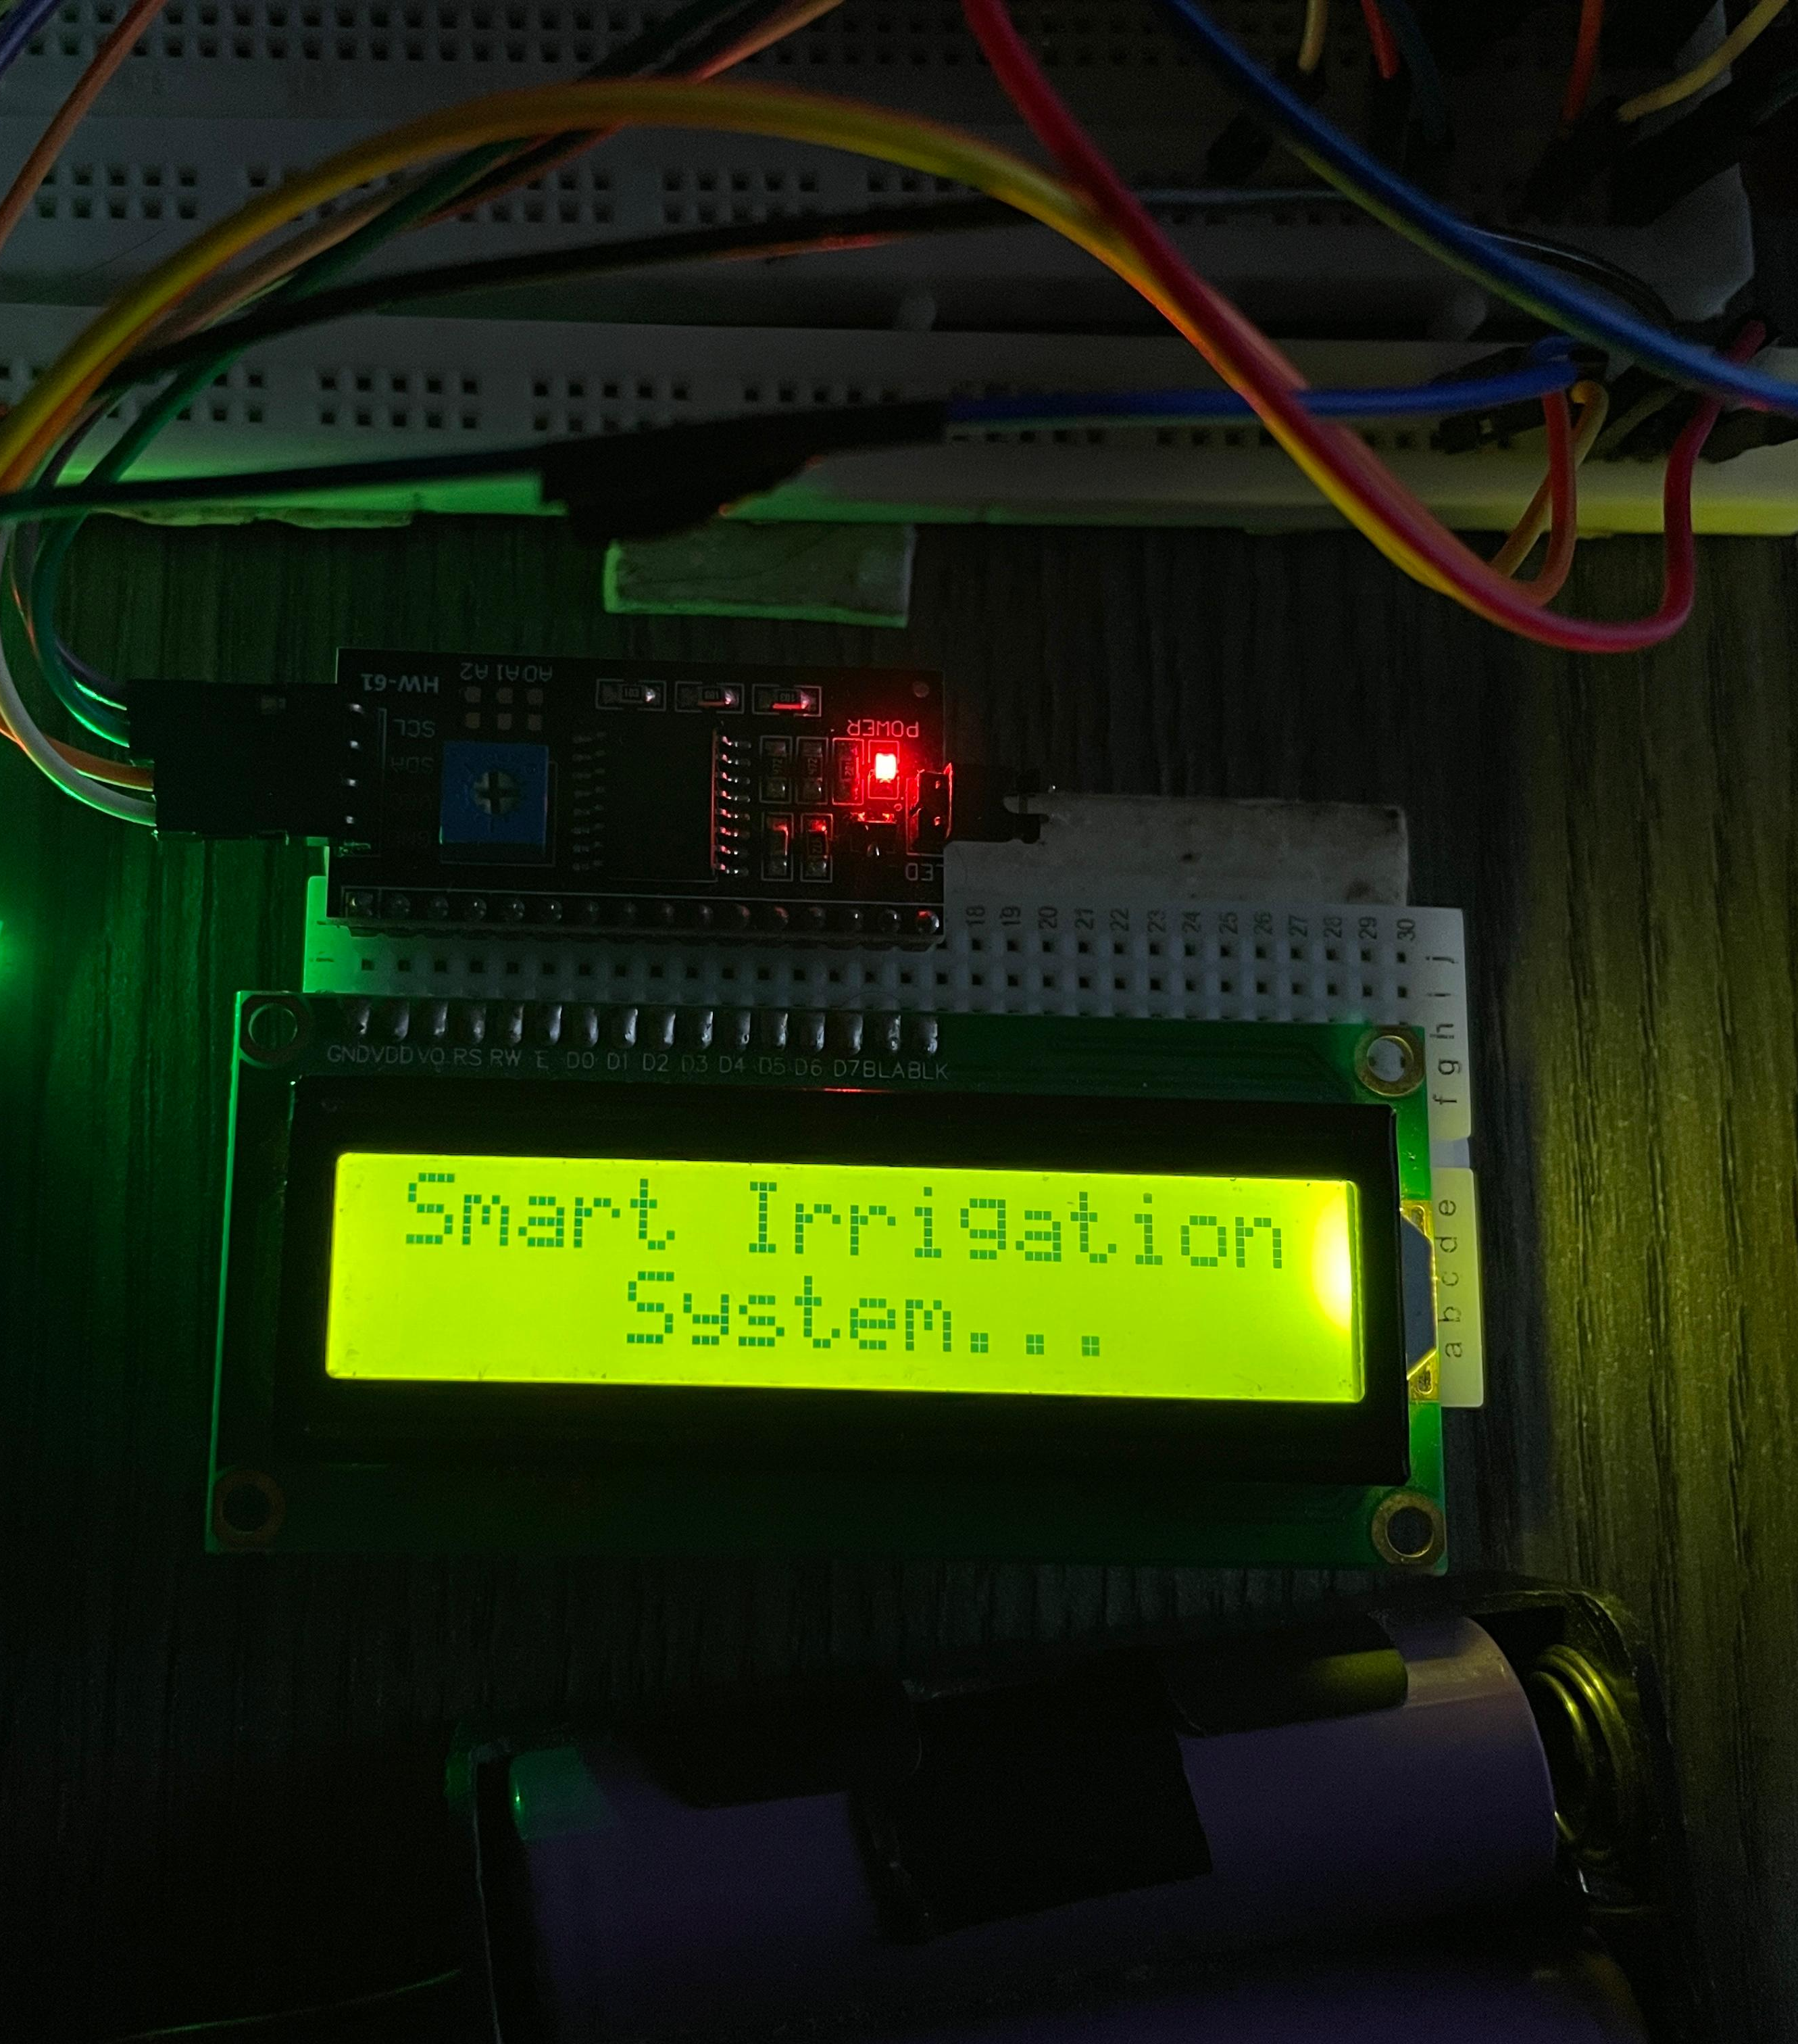
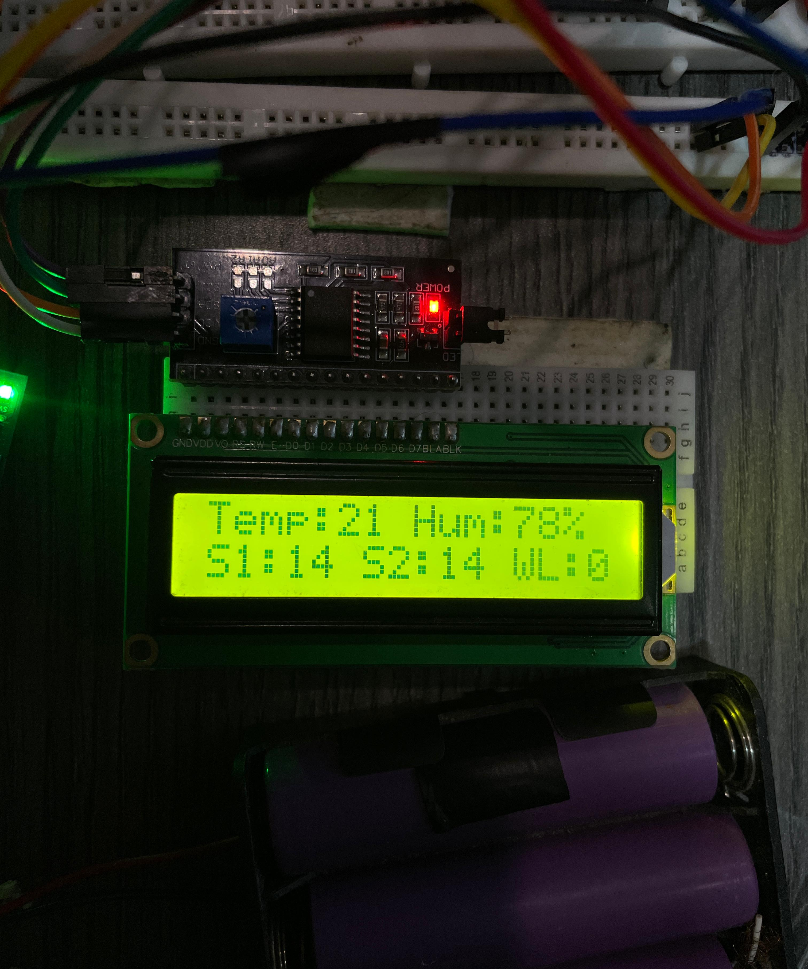
Project Demonstration

Slide 18
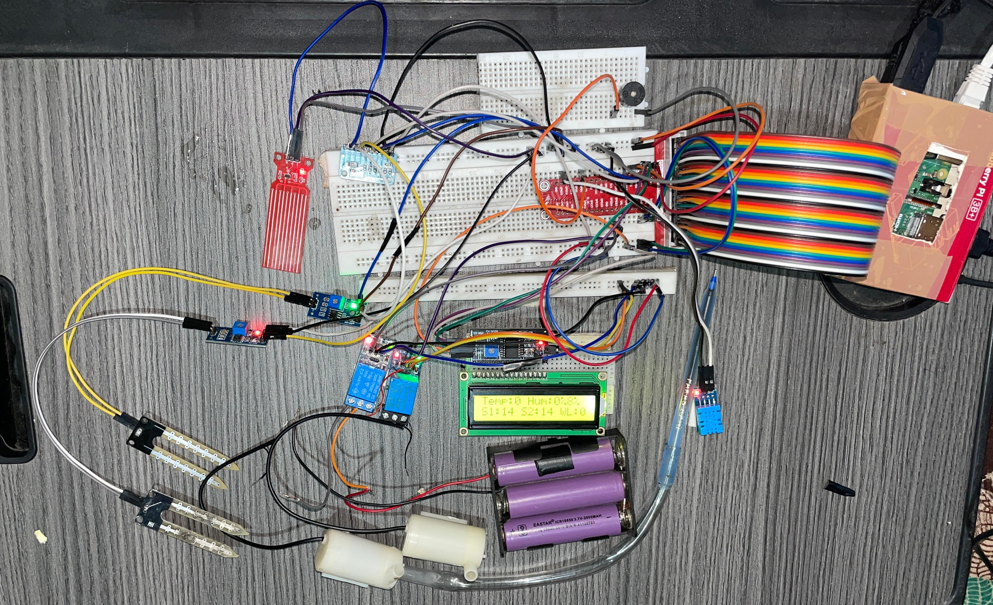

Slide 19
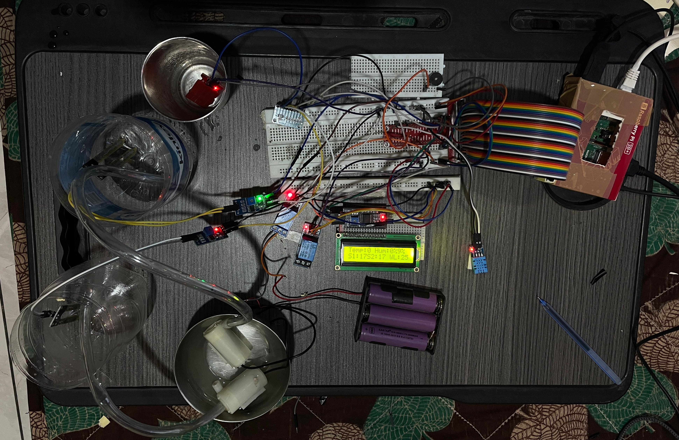

Slide 20
Appendix
import RPi.GPIO as GPIO
from time import sleep
import board
import digitalio
import busio
from adafruit_character_lcd.character_lcd_i2c import Character_LCD_I2C
from adafruit_mcp3xxx.mcp3008 import MCP3008
from adafruit_mcp3xxx.analog_in import AnalogIn
import blynklib
BLYNK_AUTH_TOKEN = "T5gHnLDFMZC9rvsvE355_ZhiQUHpxaIP"
blynk = blynklib.Blynk(BLYNK_AUTH_TOKEN)
GPIO.setmode(GPIO.BCM)
RELAY_PIN1 = 4
RELAY_PIN2 = 5
GPIO.setup(RELAY_PIN1, GPIO.OUT)
GPIO.setup(RELAY_PIN2, GPIO.OUT)
GPIO.output(RELAY_PIN1, GPIO.HIGH)
GPIO.output(RELAY_PIN2, GPIO.HIGH)
spi = busio.SPI(clock=board.SCK, MISO=board.MISO, MOSI=board.MOSI)
cs = digitalio.DigitalInOut(board.D5)
mcp = MCP3008(spi, cs)
soil_channel1 = AnalogIn(mcp, 0)
soil_channel2 = AnalogIn(mcp, 1)
water_channel = AnalogIn(mcp, 2)
i2c = busio.I2C(board.SCL, board.SDA)
lcd_columns = 16
lcd_rows = 2
lcd = Character_LCD_I2C(i2c, lcd_columns, lcd_rows)
min_moisture = 0
max_moisture = 65535
min_val = 0
max_val = 65535
V0 = 0
V1 = 1
V2 = 2
V3 = 3
V4 = 4

Slide 21
def read_soil_moisture(channel):
return (max_moisture - channel.value) * 100 / (max_moisture - min_moisture)
def read_water_level():
value = water_channel.value
water_level = (max_val - value) * 100 / (max_val - min_val)
return int(100 - water_level)
@blynk.handle_event('write V2')
def relay_control1(pin, value):
if int(value[0]) == 1:
GPIO.output(RELAY_PIN1, GPIO.LOW)
lcd.clear()
lcd.message = 'Motor1: On'
else:
GPIO.output(RELAY_PIN1, GPIO.HIGH)
lcd.clear()
lcd.message = 'Motor1: Off'
@blynk.handle_event('write V4')
def relay_control2(pin, value):
if int(value[0]) == 1:
GPIO.output(RELAY_PIN2, GPIO.LOW)
lcd.clear()
lcd.message = 'Motor2: On'
else:
GPIO.output(RELAY_PIN2, GPIO.HIGH)
lcd.clear()
lcd.message = 'Motor2: Off'
def display_and_control():
soil_moisture1 = int(read_soil_moisture(soil_channel1))
soil_moisture2 = int(read_soil_moisture(soil_channel2))
water_level = read_water_level()
lcd.clear()
lcd.message = f'SM1:{soil_moisture1}% SM2:{soil_moisture2}%\nWL:{water_level}%'
blynk.virtual_write(V0, soil_moisture1)
blynk.virtual_write(V3, soil_moisture2)
blynk.virtual_write(V1, water_level)
if soil_moisture1 < 45:
GPIO.output(RELAY_PIN1, GPIO.LOW)
lcd.clear()
lcd.message = 'Motor1: On'
blynk.virtual_write(V2, 1)
else:
GPIO.output(RELAY_PIN1, GPIO.HIGH)
lcd.clear()
lcd.message = 'Motor1: Off'
blynk.virtual_write(V2, 0)
if soil_moisture2 < 45:
GPIO.output(RELAY_PIN2, GPIO.LOW)
lcd.clear()
lcd.message = 'Motor2: On'
blynk.virtual_write(V4, 1)

Slide 22
else:
GPIO.output(RELAY_PIN2, GPIO.HIGH)
lcd.clear()
lcd.message = 'Motor2: Off'
blynk.virtual_write(V4, 0)
lcd.clear()
lcd.message = 'Starting...'
sleep(2)
lcd.clear()
lcd.message = 'Motor1: Off\nMotor2: Off'
try:
while True:
display_and_control()
blynk.run()
sleep(1)
except KeyboardInterrupt:
print("Program interrupted")
finally:
GPIO.cleanup()
lcd.clear()
print("Cleanup complete")

Slide 23
Thank You

